Slide 1

UNVEILING THE VEILED: EXPLORING STEGANOGRAPHY AND EMERGING TRENDS
Presented by Ms. Madhumanti Das (RA2111003020267)

Slide 2


AGENDA
Abstract
Introduction
History of Steganography
Existing System
Proposed System
Architecture
Design
Methodology
Comparison between old and new technologies
Applications
Advantages
Conclusion

Slide 3

ABSTRACT
Steganography is the art and science of hiding information within other data in a way that is difficult to detect or decipher. It has a rich history dating back to ancient times, but in recent years, it has seen significant advancements and new trends driven by advances in technology.
In the era of Big Data and cybersecurity concerns, steganography has found new applications in data protection and covert communication. Emerging trends include the use of deep learning algorithms for more sophisticated data embedding, making detection increasingly challenging. Additionally, steganography in multimedia, such as images and videos, has gained prominence, presenting novel challenges and opportunities.
This seminar report explores the fundamentals of steganography, its historical context, and the latest trends in this field, including emerging techniques and applications.

Slide 4

INTRODUCTION
The word steganography comes from the Greek words "steganos" (hidden) and "graphein" (to write). Steganography is the practice of concealing secret information within non-secret information, known as the cover text. Unlike cryptography, which focuses on securing the content of a message through encryption, steganography aims to hide the very existence of the message itself. This makes it a powerful tool for covert communication and data protection.

Slide 5


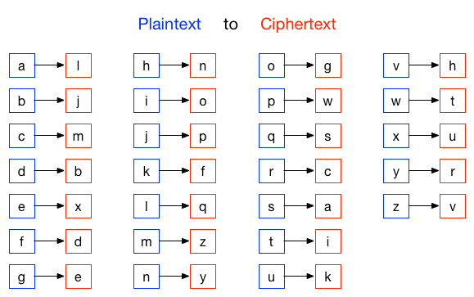
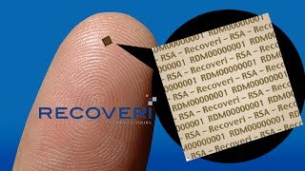
HISTORY OF STEGANOGRAPHY
WAX TABLET
INVISIBLE INK
NULL CIPHER
MICRODOTS

Slide 6
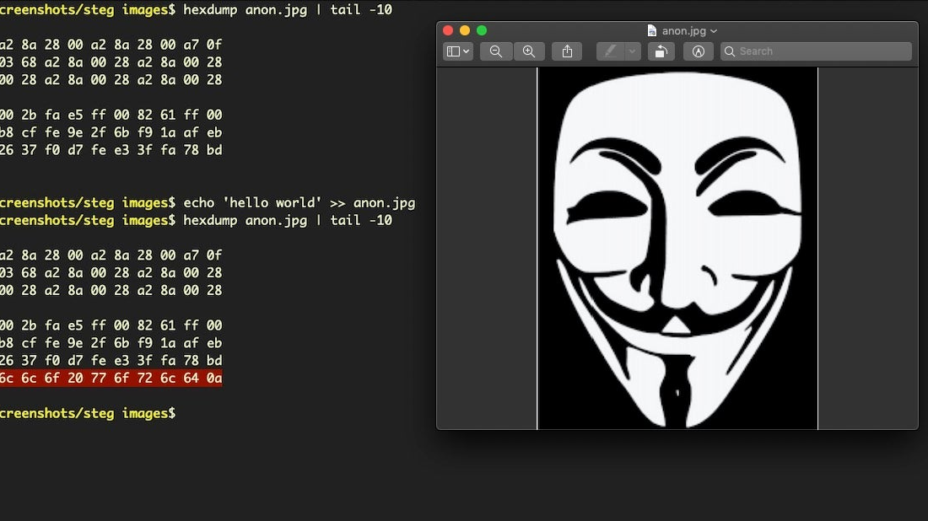
EXISTING SYSTEM
a. Least Significant Bit (LSB) Steganography: Alters the least significant bits of the cover image's pixels to encode data.
b. Spread Spectrum: Distributes the secret data across a broader spectrum to minimize detectability.
c. Transform Domain Techniques: Embeds data in the frequency or wavelet domain of the cover image.
d. Text Steganography: Embeds data within text documents, often by modifying the spacing, punctuation, or font characteristics

Slide 7
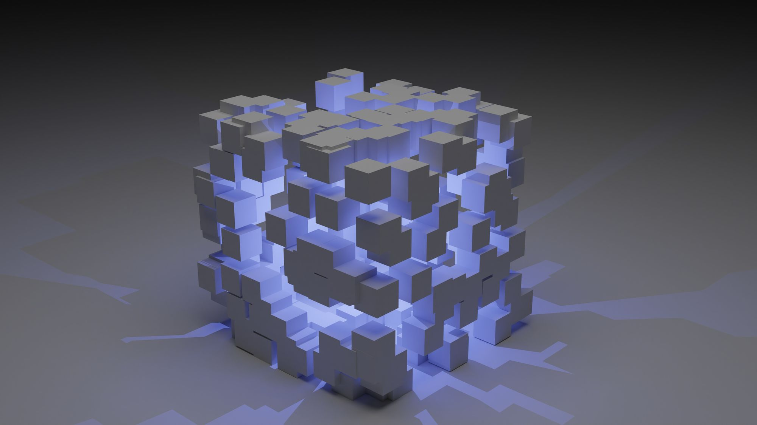
PROPOSED SYSTEM
A proposed system of steganography with generative AI would combine the principles of steganography with the capabilities of generative artificial intelligence to hide information within digital media such as images, audio, or video. Steganography is the practice of concealing a message or information within another file in such a way that it is difficult to detect. Generative AI, on the other hand, can be used to create and manipulate content in a highly sophisticated manner.
SYSTEM OVERVIEW:
Data Embedding
Message Extraction:
Security and Detection
Customization and Embedding Strategies:
User Authentication and Access Control:
Legal and Ethical Considerations
Testing and Evaluation

Slide 8




hgfhdgfhg2343mdsaa456
CRYPTOGRAPHY
INTRUDER UNDERSTAND THAT SECRET MESSAGE IS BEING SENT
STEGANOGRAPHY
AI BASED STEGANOGRAPHY IS USED
INTRUDER WILL NOT GET TO KNOW OF THE EXISTENCE OF SECRET MESSAGE

Slide 9
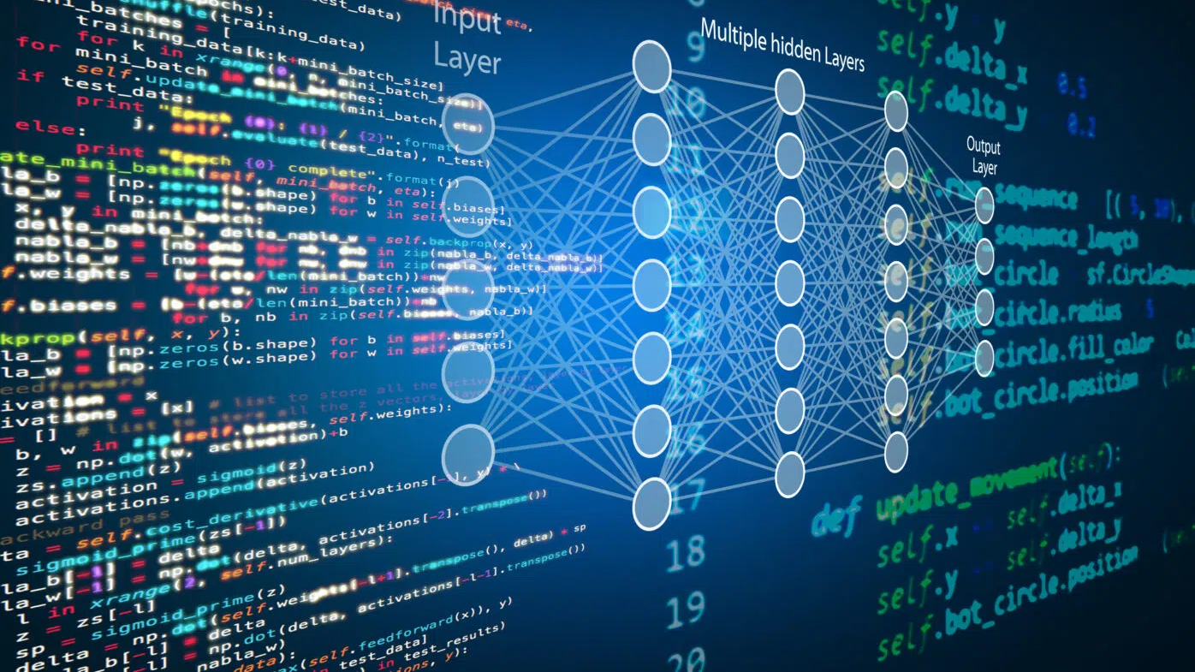
DESIGN
DATA ENCODING
Decide what kind of data you want to hide (e.g., text, images, or other binary data).
Convert the data into a suitable format for embedding within the cover media
COVER MEDIA SELECTION
Choose the type of cover media to hide the data in (e.g., images).
Gather a dataset of cover media that your Generative AI model can use for creating steganographic content.
GENERATIVE AI MODEL
Train or fine-tune a Generative AI model (such as a GAN or VAE) to create content that resembles your chosen cover media type.
The model should be trained to generate media that is indistinguishable from genuine cover media.
DATA EMBEDDING
Develop an algorithm that takes the cover media generated by the AI model and embeds the data within it.
Make sure the embedding process is imperceptible, meaning it doesn't introduce any noticeable artifacts.
DECODING AND EXTRACTION
Create a corresponding algorithm for decoding and extracting the hidden data from the steganographic media.
Ensure the extraction process is as secure as the encoding process to prevent unauthorized access.
ENCRYPTION
To add an extra layer of security, you can encrypt the data before embedding it within the media.

Slide 10
DESIGN
TESTING AND EVALUATION
Evaluate the system by testing it with various cover media and data types.
Ensure that the steganographic media appears visually or audibly similar to real cover media.
Verify the effectiveness of the data extraction process.
SECURITY CONSIDERATIONS
Pay attention to the security aspects. Implement authentication mechanisms to ensure that only authorized parties can access the hidden data.
Use secure encryption algorithms for added protection.
LEGAL AND ETHICAL CONSIDERATIONS
Be aware of the legal and ethical implications of steganography. Make sure your system is used for lawful purposes.
DOCUMENTATION AND USER INTERFACE
Create documentation for users on how to use your steganography system.
Develop a user-friendly interface for interacting with the system.
DEPLOYMENT
Deploy the steganography system in a controlled environment where it's intended to be used.

Slide 11

METHODOLOGY
Deep Learning and Neural Networks: Recent advancements in deep learning have led to the development of steganographic techniques that use neural networks for both hiding and detecting hidden data.
Adversarial Attacks and Defenses: The field has seen the emergence of adversarial attacks and defenses, where attackers try to exploit steganography and defenders develop countermeasures.
Steganography in Multimedia: Steganography is increasingly applied to multimedia data, including images, audio, and video, with new techniques tailored to these domains.
Steganography in the Cloud: As data storage and processing move to the cloud, there is growing interest in steganography techniques that are compatible with cloud-based systems.
Quantum Steganography: As quantum computing technology progresses, researchers are exploring quantum steganography methods and their implications.

Slide 12
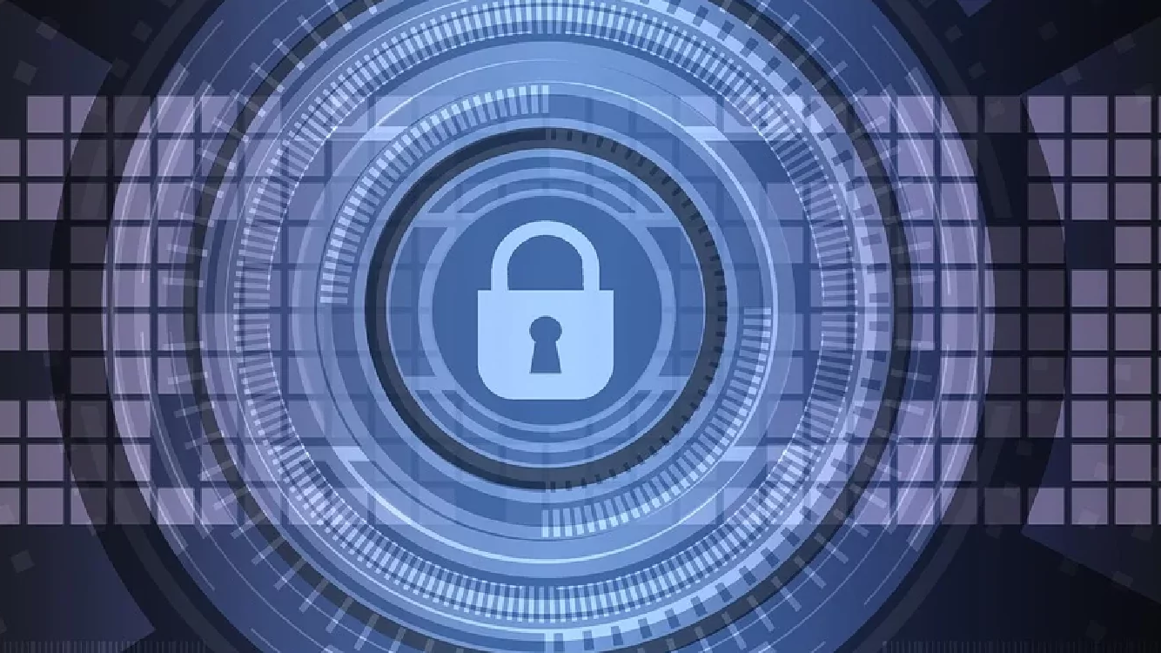
OLD VS NEW TECHNOLOGY
TRADITIONAL STEGANOGRAPHY
STEGANOGRAPHY USING GENERATIVE AI
HIDING METHODS
Traditional methods typically involve techniques like LSB (Least Significant Bit) replacement, where the least significant bits of the cover medium are altered to embed the data. This can be easily detected using statistical analysis.
SECURITY
Traditional steganography methods are generally less secure and easier to detect because they often leave statistical traces or anomalies in the cover medium.
COMPLEXITY
Traditional steganography methods are generally simpler to understand and implement but may also be easier to detect.
ADAPTABILITY
Traditional methods are often static and may not adapt well to changing cover media or evolving steganalysis techniques.
HIDING METHODS
AI-based steganography may use more sophisticated methods like neural networks to hide data, making it harder to detect. It can learn complex patterns in the cover medium to embed data.
SECURITY
AI-based steganography can be more secure because it can generate cover media that appear more natural and less suspicious. This makes it harder for traditional steganalysis techniques to detect hidden data.
COMPLEXITY
Employing generative AI adds a level of complexity, both in terms of creating and detecting hidden information. It requires knowledge of AI models, which can be a barrier for some users.
ADAPTABILITY
AI-based methods can adapt to different cover media types and can evolve to counter new steganalysis techniques, as they are based on machine learning models.

Slide 13
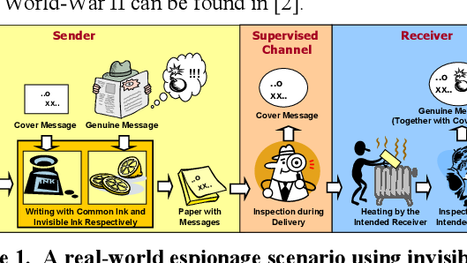
APPLICATIONS
a. DIGITAL WATERMARKING: Protecting intellectual property in images and videos.
b. SECURE COMMUNICATION: Covertly transmitting messages in a way that avoids suspicion.
c. DATA PROTECTION: Concealing sensitive data within other files to prevent unauthorized access.
d. AUTHENTICATION: Verifying the authenticity of digital content through hidden signatures.

Slide 14

ADVANTAGES
Security: Steganography provides a high level of security for sensitive information. Since the hidden message is not apparent to casual observers, it is less likely to be intercepted or compromised during transmission.
Covert Communication: It allows for covert communication, making it suitable for espionage, confidential data transfer, and privacy protection.
Data Hiding: Steganography can be applied to various types of data, including text, images, audio, and video, making it versatile for concealing different types of information.
Resistance to Attacks: Well-designed steganographic techniques can be resistant to various forms of analysis, such as statistical analysis and visual inspection, making it difficult for adversaries to detect the hidden data.
Integration with Encryption: Steganography can be used in conjunction with encryption to add an extra layer of security. Even if an attacker detects the presence of hidden data, they may not be able to decipher it without the appropriate decryption key.
Low Impact: When used properly, steganography has a minimal impact on the cover media (e.g., image quality, audio quality), ensuring that the hidden message remains concealed without causing noticeable degradation.

Slide 15

CONCLUSION
The responsible and ethical use of steganography is important for a number of reasons. First, it can be used to protect sensitive information from unauthorized access. For example, steganography can be used to hide medical records, financial information, or military secrets. Second, steganography can be used to preserve privacy. For example, steganography can be used to hide messages from government surveillance or corporate monitoring. Third, steganography can be used to facilitate communication in hostile environments. For example, steganography can be used to hide messages from censors or to communicate with dissidents.
The ever-evolving nature of steganography means that there is a need for continuous research and innovation in this area. As new steganographic techniques are developed, so too must new steganalysis techniques be developed to detect them. This arms race between steganography and steganalysis is constantly evolving, and it is important for researchers to stay ahead of the curve.

Slide 16

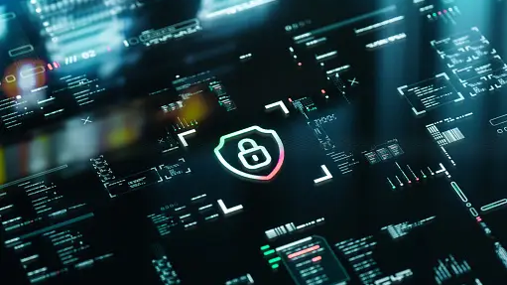



THANK YOU

